Slide 1

Introduction to R Session 1
Dr. Muhammad Muhammad
Chair of Quantitative Methods in the Social Sciences
Chair of International Relations

Slide 2

Course Instructor

Slide 3
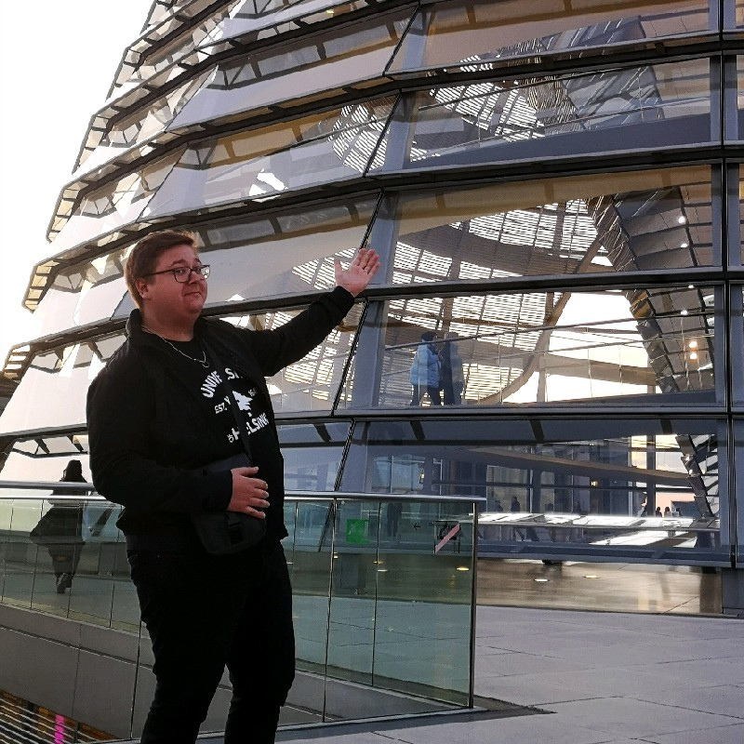


About this course
We will cover the basics of data manipulation in R
Building on previous teaching material prepared by:
Leon Siefken
Okan Sarioglu
Dr. Lion Behrens
Course Link
Course Link

Slide 4
Why this course? Why R?
R is a free and open-source
Easy to get started with R-Studio
Used in academia and the industry
Wide userbase; most likely someone ran into the same issue as you
Even ChatGPT can help with problems
Designed for statistical analyses
Simplifies every step of your analysis

Slide 5
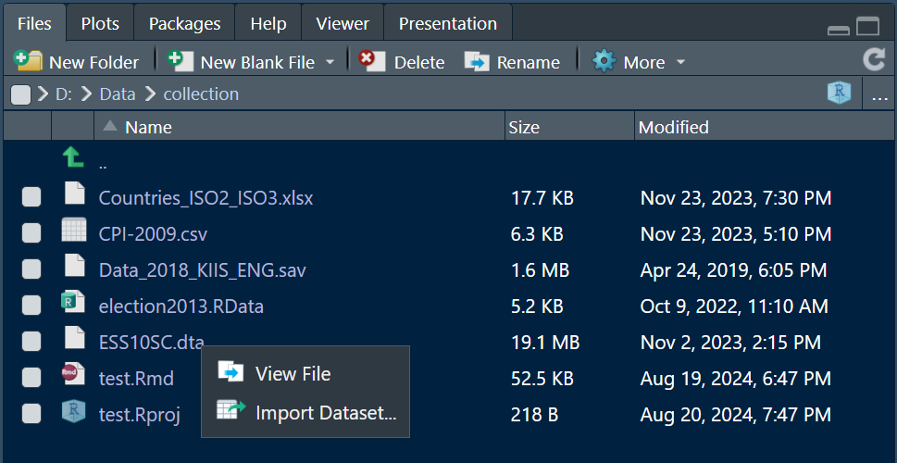
Importing and Working with Different Types of Data

Slide 6
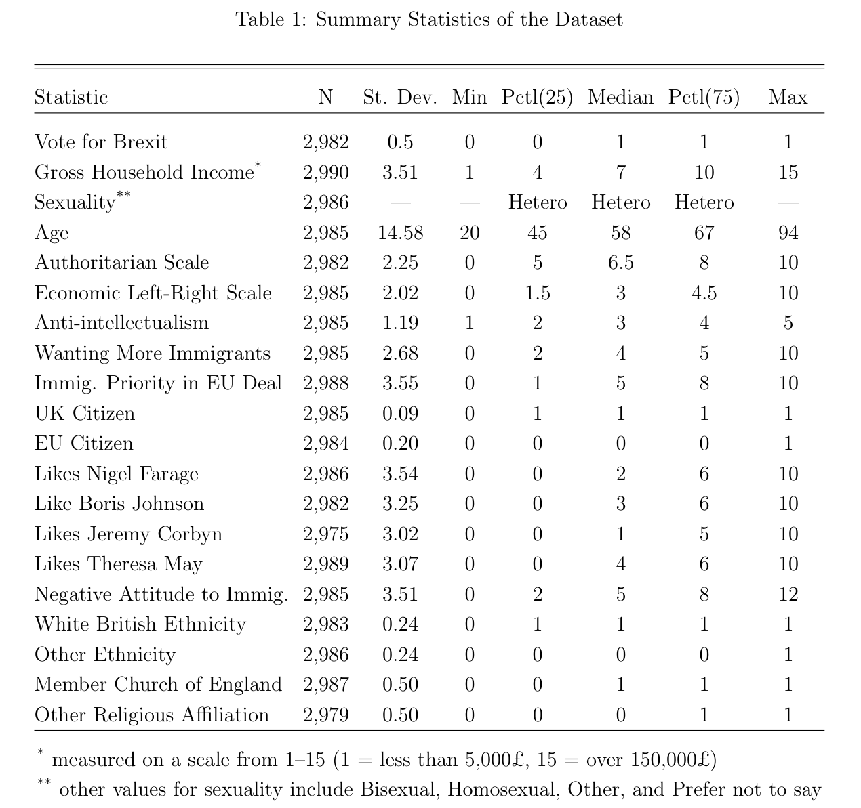
Produce formatted summary statistics tables

Slide 7
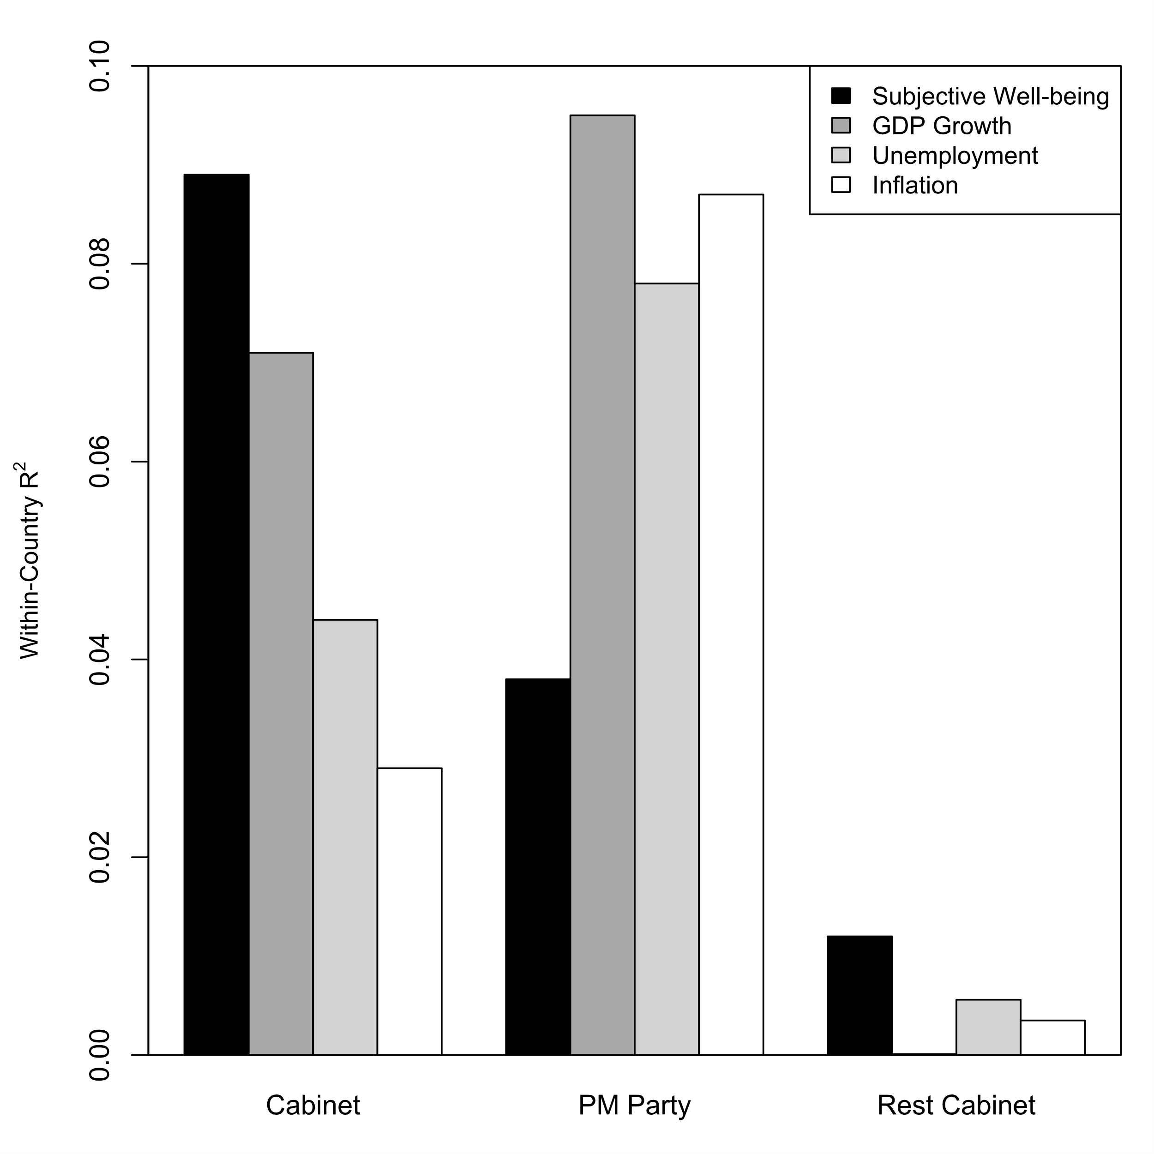
Calculate Correlations and Plot them nicely

Slide 8
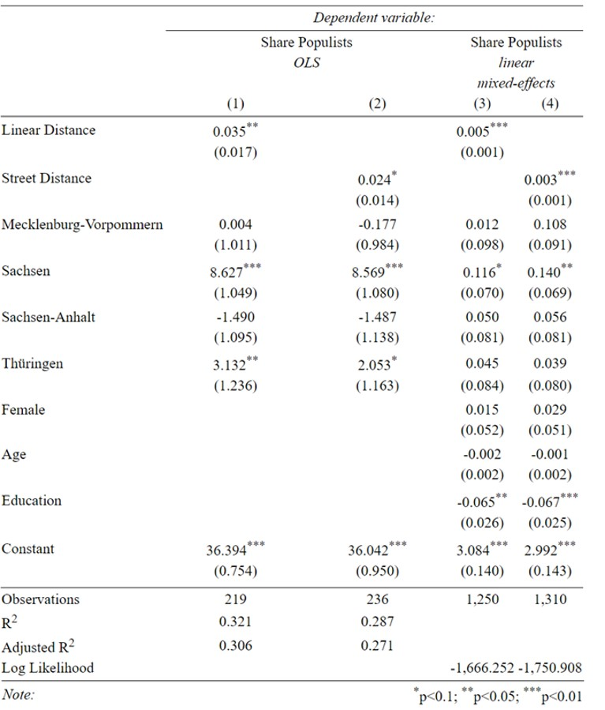
Run Regressions and Produce Regression Tables

Slide 9
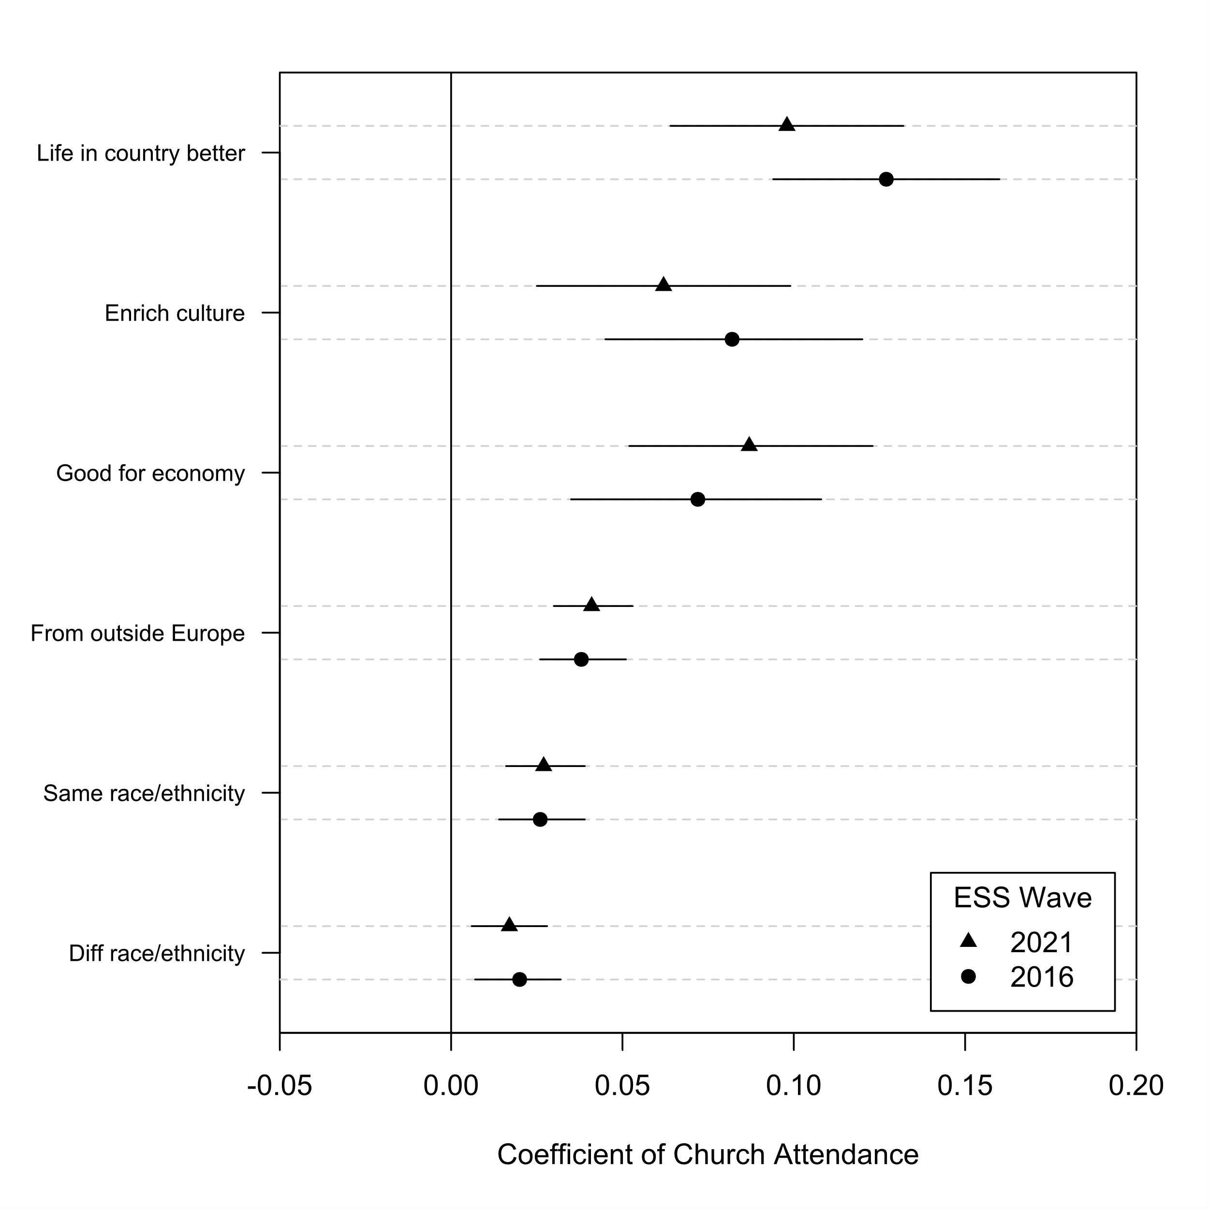
Plot regression results

Slide 10
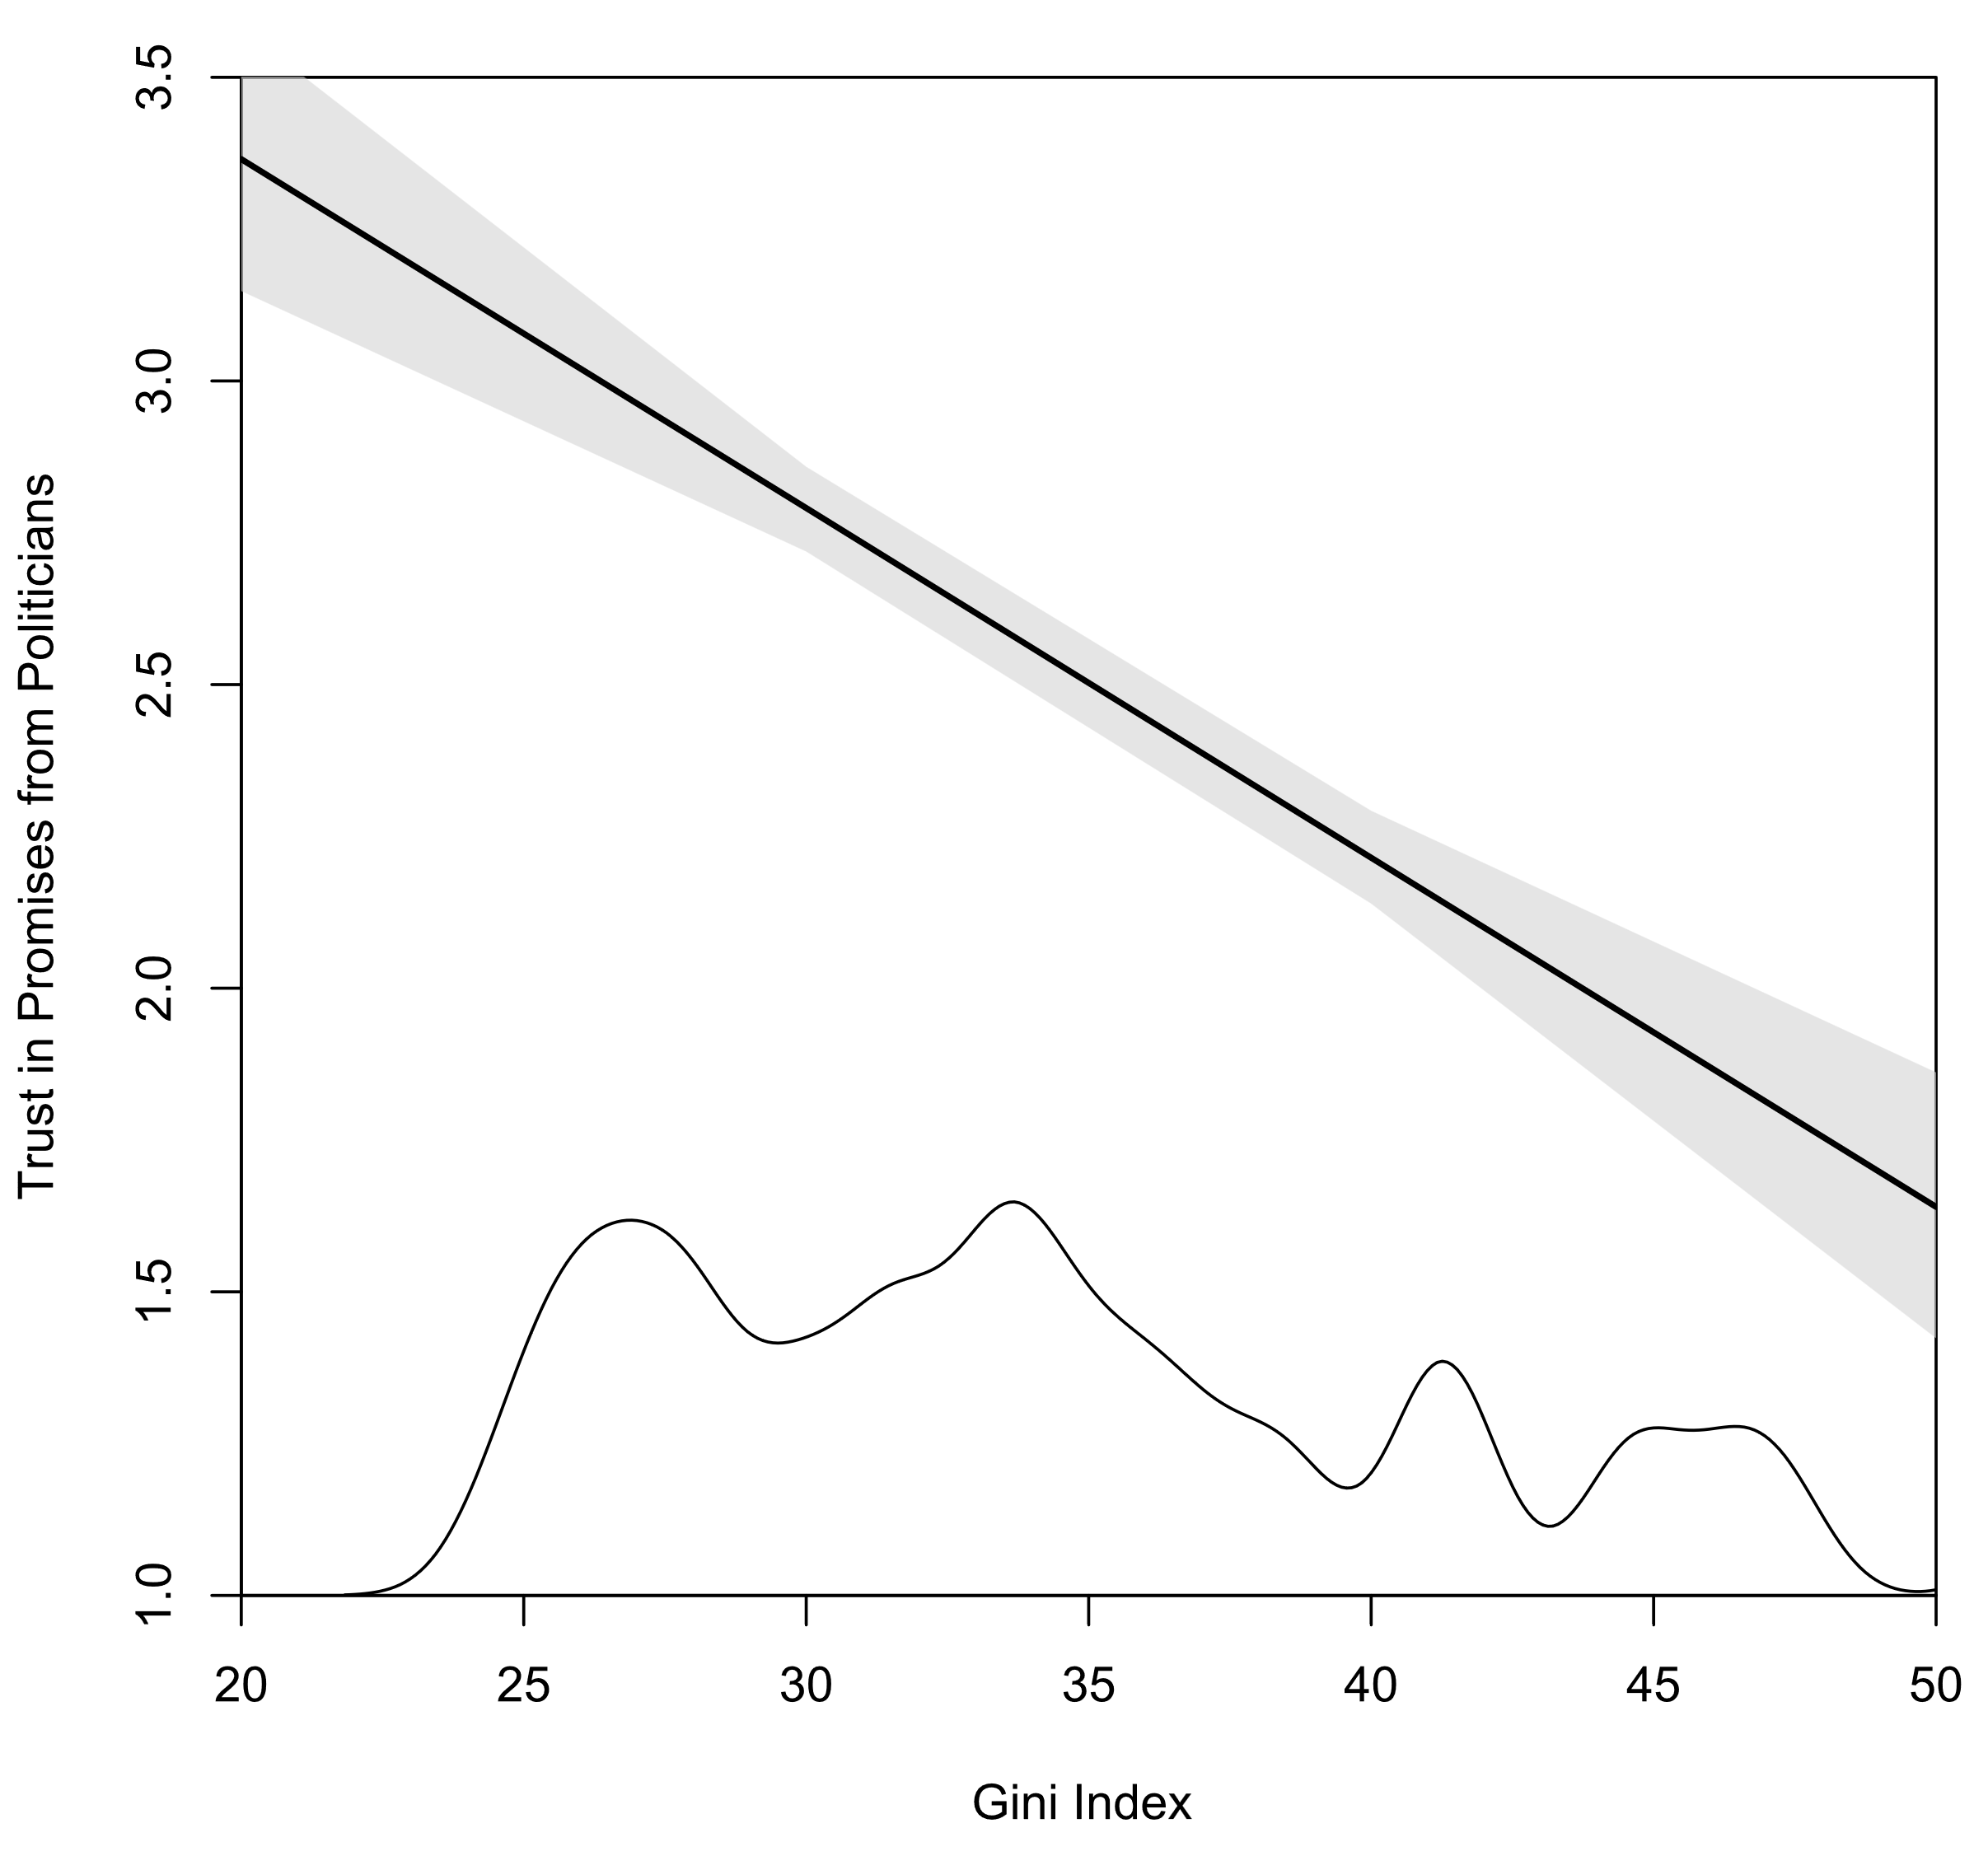
Get more substantive findings using simulations

Slide 11
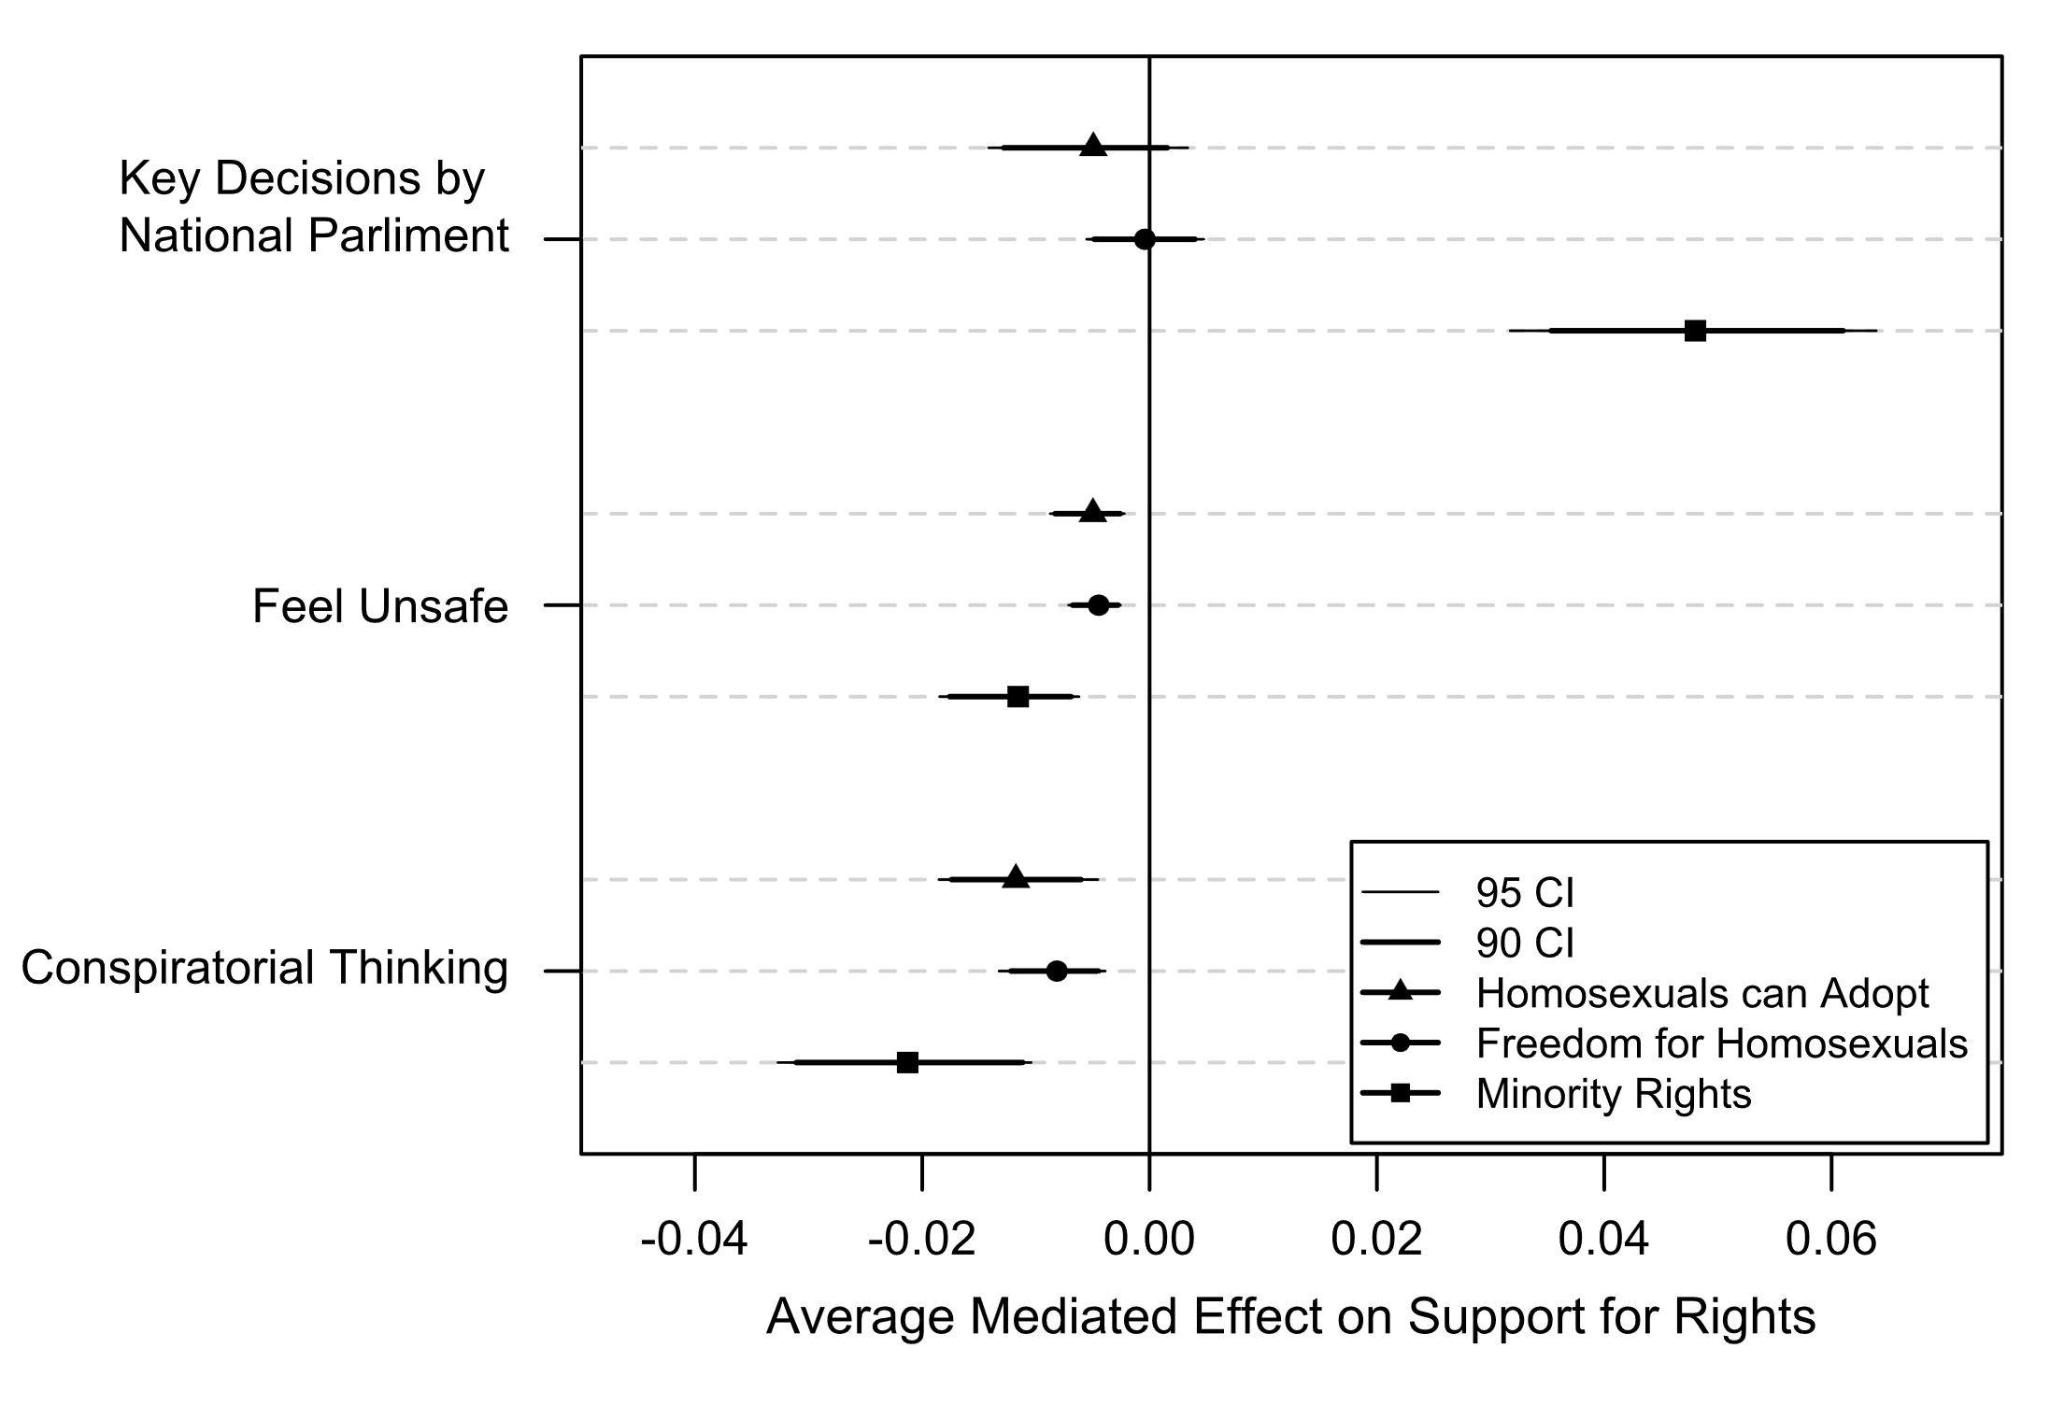
Carry out advanced analyses (e.g. Mediation Analysis)

Slide 12
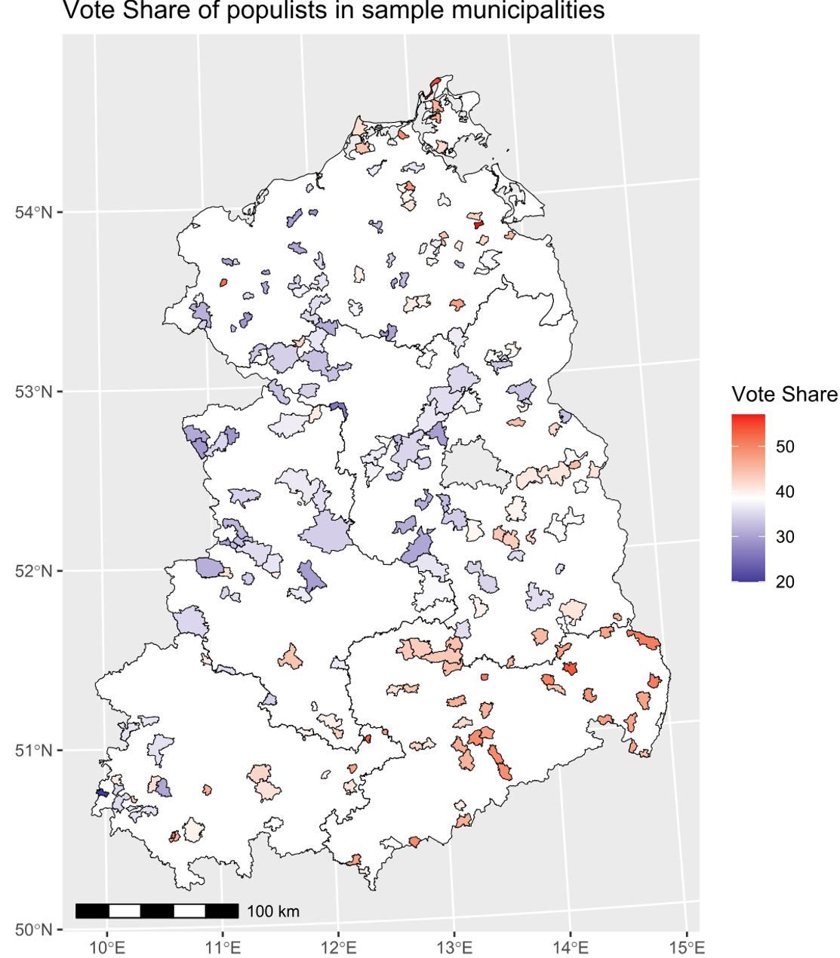
Process and Present
Spatial Data

Slide 13
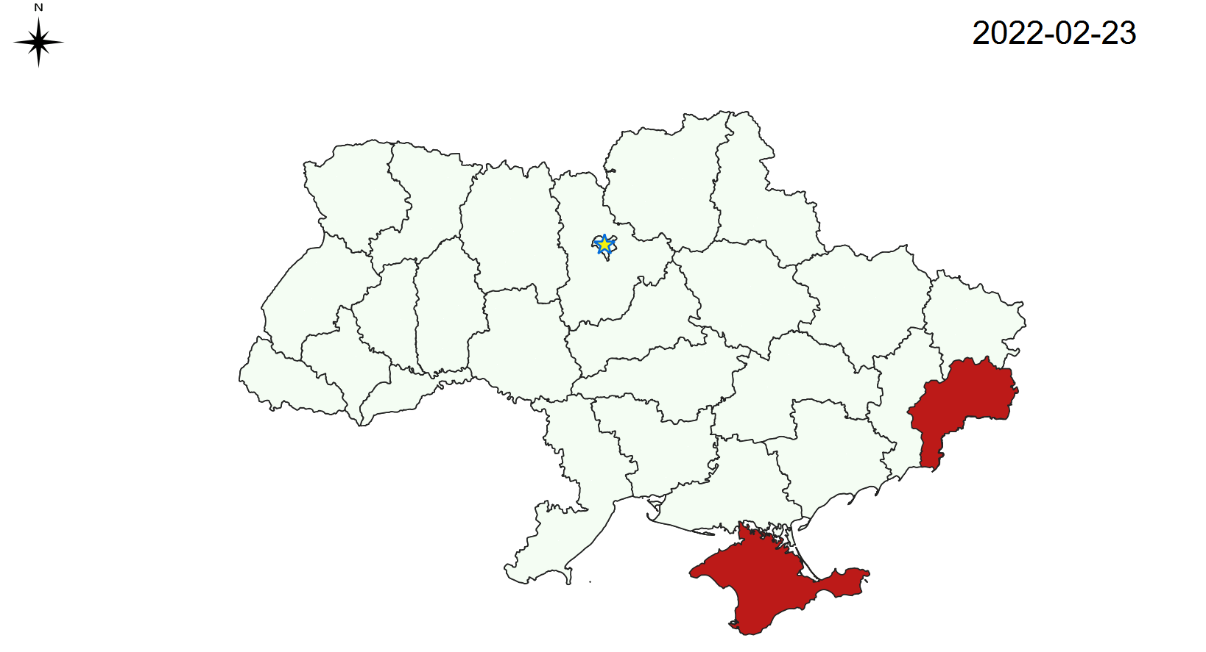
Collect data (e.g. Web-scraping)

Slide 14
Most Importantly, frees you up to take care of the rest of your paper!
Research Question
Theory & Lit. Review
Data & Methods
Results & Discussion
Conclusions & Limitations
The world is bigger than just this!

Slide 15
Course Contents
Let’s have a look at the Syllabus
In a nutshell :
Sessions 1 and 4: Most important intuitions
Session 2: Most practical use for people with coding experience
Sessions 3 (and maybe 5): Things you can pick up on your own

Slide 16
Then let’s get started with RStudio!
R files include:
R-scripts .r, a series in R commands saved in one file
RMarkdown .Rmd, formatted text and code chucks (mini R-scripts)
Session data .RData, stores results from current session
R Project .Rproj, ties all your files together and you don’t have to worry about telling R what your current directory is

Slide 17
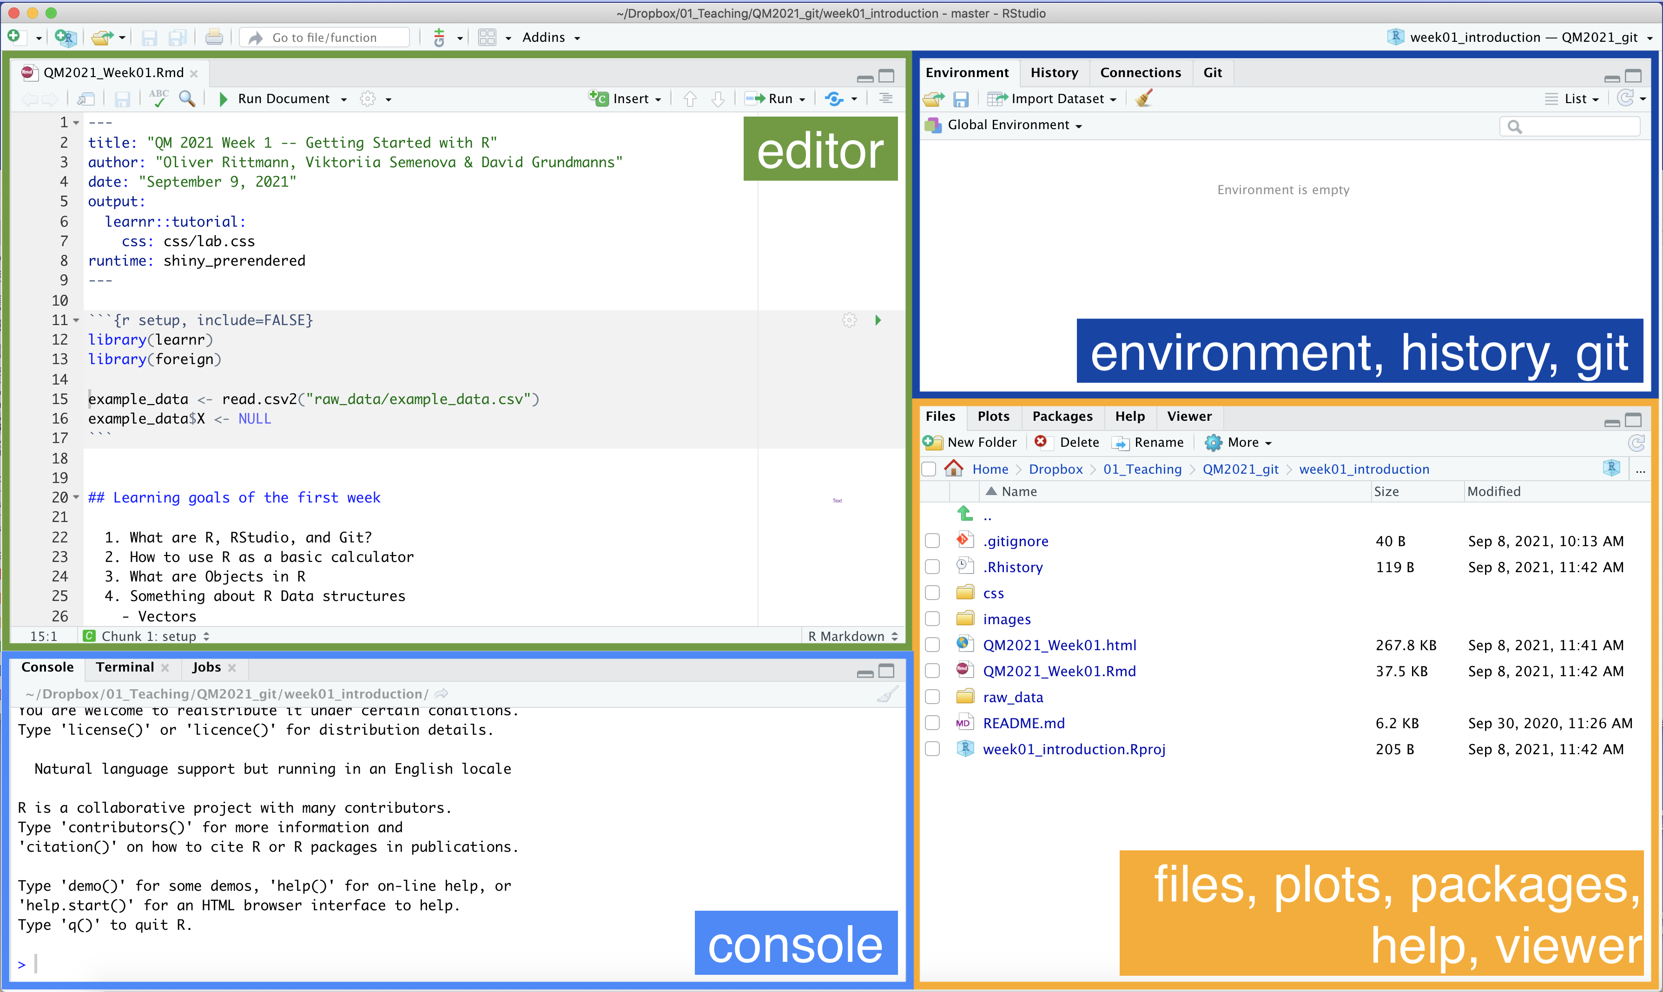
RStudio in a glance

Slide 18
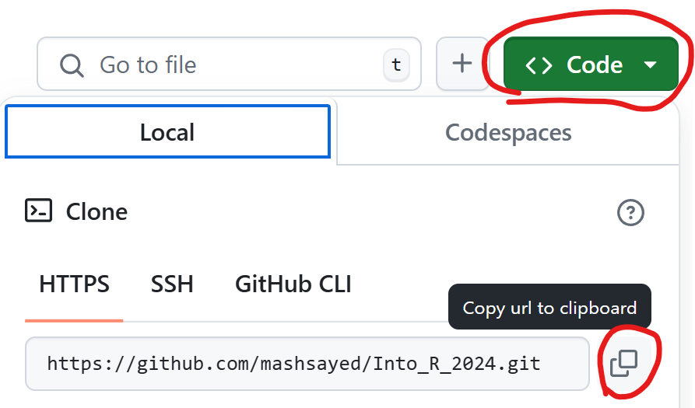
Connecting to Github
Install and get Git running: https://github.com/git-guides/install-git
Git streamlines the process of retrieving, editing, and sharing code
Go to course repository: https://github.com/mashsayed/Into_R_2024
Copy link of repository

Slide 19
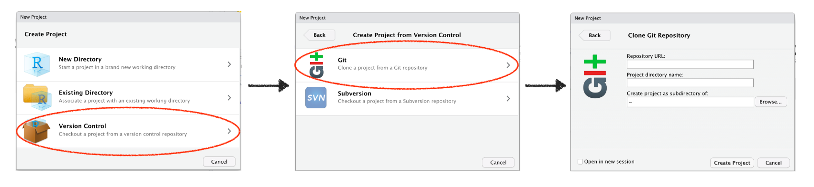
Start R project using Github
Open Rstudio >> file >> New Project…

Slide 20
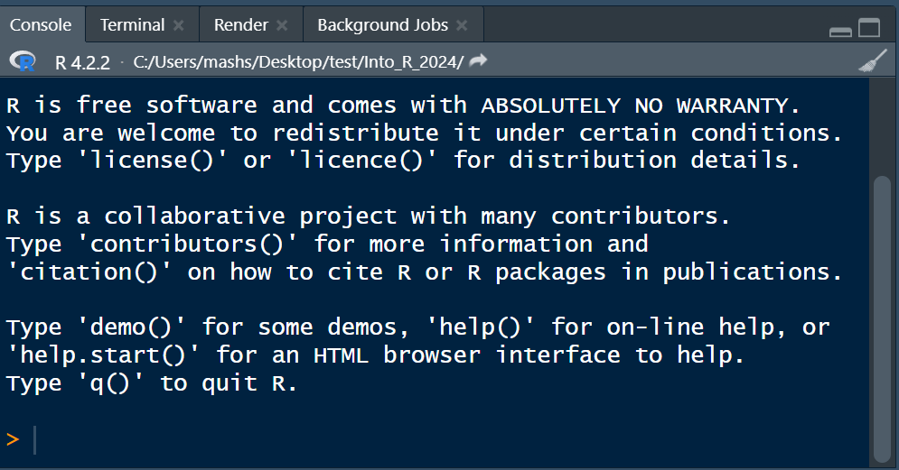
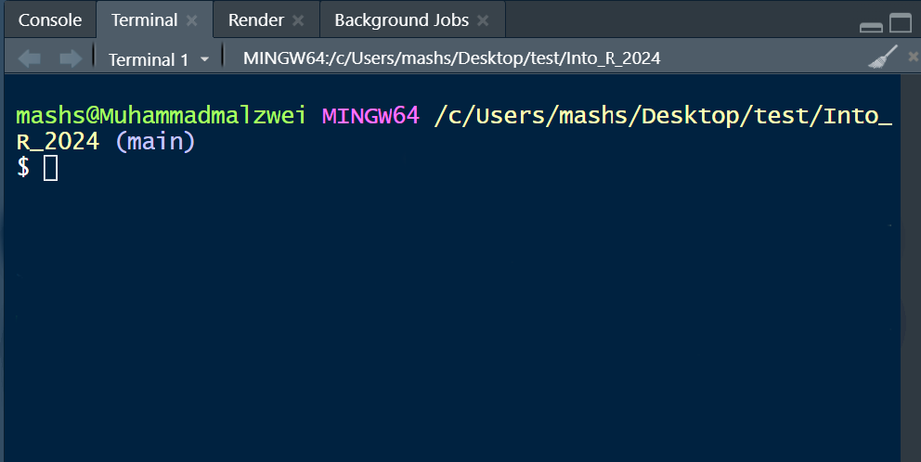
Connecting Git to your GitHub Account
In the terminal type in the following commands:
git config --global user.name “your username"
git config --global user.email “your_email@example.com"

Slide 21
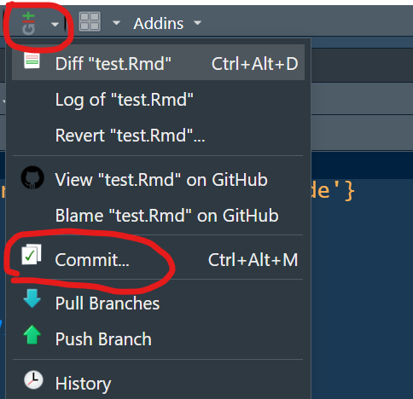
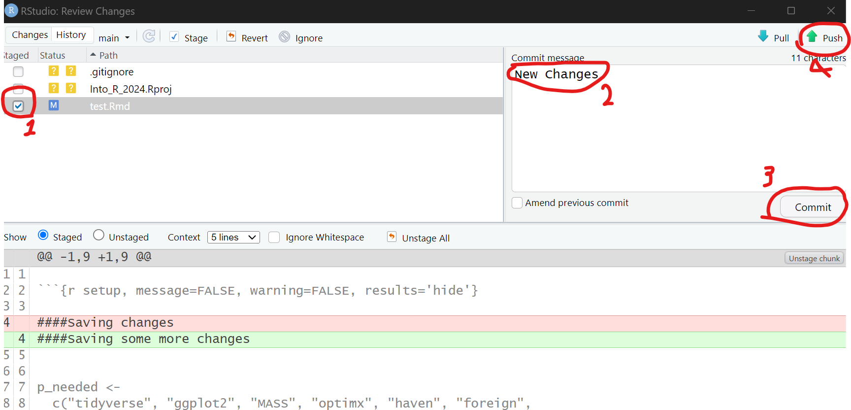
Pulling, Committing, and Pushing
Pull: download files from the repository
Commit + Push: upload your changes

